Slide 1
Helpful Resources for
Undergraduate Research

Slide 2
Common Myths and Misunderstandings
Prior experience is needed to get a research position
MYTH
Most students join a lab with little to no experience – even some graduate students start research without having had prior lab experience. It is just important to show dedication and attentiveness.
If I don’t hear anything from the professor, then that means I did not get the position
MYTH
Professors are very busy, and emails usually get buried – Reach out to the professor again after 2 weeks if you have not heard back from him/her
Its better to reach out to a professor when you are an upperclassman
MYTH
Though you want to wait until you feel comfortable with your class load and extracurriculars, its never too early to reach out. Also, conversely it is never too late. If you find research that piques your interest, reach out to the professor for a meeting.
Students should choose research in their major.
MYTH
Don’t limit your search for research to your major. There are many interdisciplinary and collaborative work going on across the UW. Find something that makes you curious and don’t be afraid to go outside your comfort zone.

Slide 3
Helpful Resources
URP website
https://www.washington.edu/undergradresearch/students/find/
UW Libraries
https://canvas.uw.edu/courses/1388650
Scholarships and Funding Opportunities
Mary Gates Scholarship
Washington Research Foundation Fellowships
https://www.washington.edu/undergradresearch/students/funding/
REU experiences https://www.washington.edu/undergradresearch/summer/summer-beyond-uw/
https://www.cei.washington.edu/education/undergraduate-students/reu/
https://uwmemc.org/education/programs/reu/
Research Opportunities
Institute for Protein Design
https://www.ipd.uw.edu/join-us/
https://new.expo.uw.edu/expo/login

Slide 4
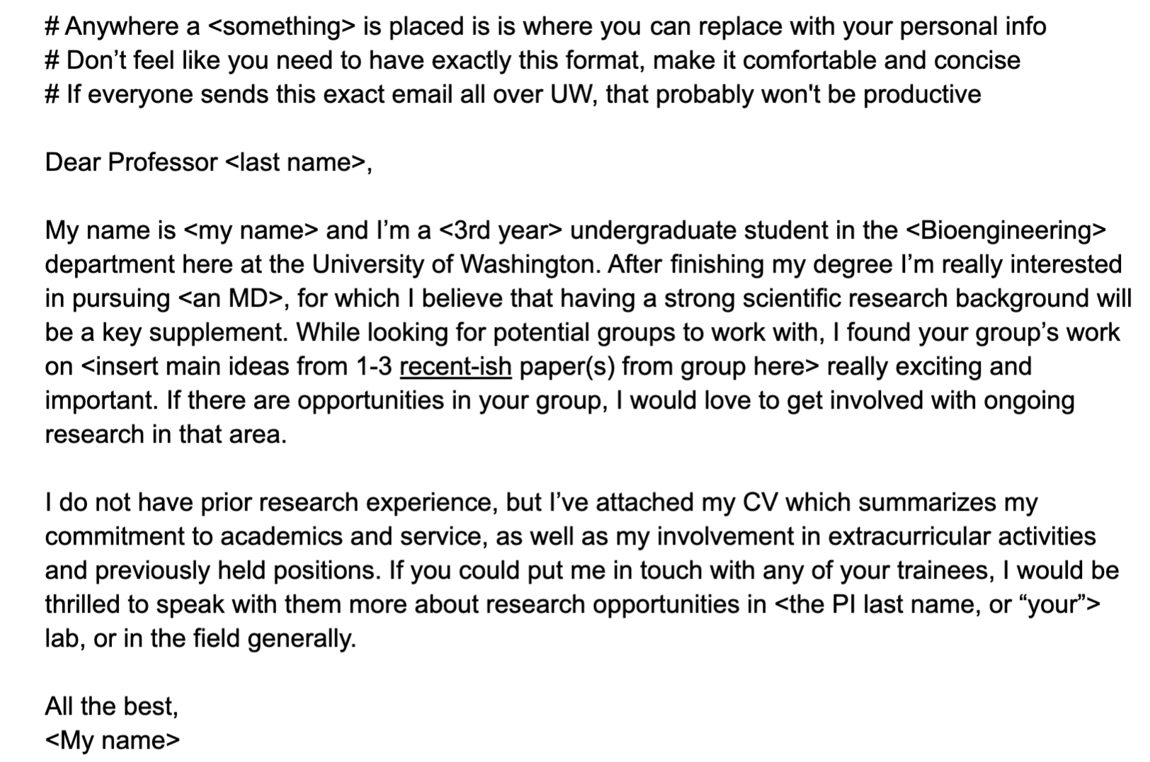
Example email template

Slide 5
Contacts
Feel free to contact us with any questions!
MolES Outreach Chair: Phuong Nguyen: nguyennp@uw.edu
Panelists:
Bonni Leeds: bkleeds@uw.edu
Evan Pepper: epepper@uw.edu
Jimmy Ye: zimingye@uw.edu
Pranav Sarda: sarda@uw.edu
Serag Sorror: serags@uw.edu

